Slide 1
NFA to DFA Conversion (Subset Construction Method)
Course Code: CSC3220
Course Title: Compiler Design
Dept. of Computer Science
Faculty of Science and Technology
Lecture No: | 9.1 | Week No: | 9 | Semester: | Summer 2020-2021
Lecturer: | MAHFUJUR RAHMAN, mahfuj@aiub.edu

Slide 2
Lecture Outline
NFA TO DFA (Subset Construction Method)
Subset Construction Algorithm
DFA Designing
Example
Exercise
References

Slide 3
Objective and Outcome
Objective:
To explain the subset construction algorithm/method for converting a Non deterministic machine to deterministic machine.
Provide necessary example and explanation of NFA to DFA conversion method using subset construction method.
To explain and practice Deterministic Finite Automata (DFA) Machine Design for a given Grammar.
Outcome:
After this lecture the students will be capable of demonstrating the subset construction algorithm
After this lecture the student will be able to convert an NFA to relevant DFA by following subset construction method.
After this class student will be able to design and demonstrate DFA construction from a given Grammar.

Slide 4
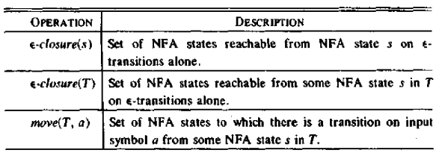
NFA to DFA Conversion
Subset Construction Algorithm
Input: An NFA N
Output: A DFA D accepting the same language
Method: Constructs a transition table Dtran for D. Each DFA state is a set of NFA states and construct Dtran so that D will simulate “in parallel” all possible moves N can make on a given input string

Slide 5
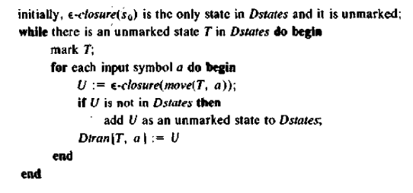
NFA to DFA Conversion
Subset Construction Algorithm

Slide 6
NFA to DFA Conversion
ε-closure and move Examples
a
1
2
ε-closure({0}) = {0,1,3,7} move({0,1,3,7},a) = {2,4,7} ε-closure({2,4,7}) = {2,4,7} move({2,4,7},a) = {7} ε-closure({7}) = {7} move({7},b) = {8} ε-closure({8}) = {8} move({8},a) = ∅
ε
start
ε
a
b
b
0
3
4
5
6
a
b
ε
7
8
b
Alphabet / Symbol = {a, b}

Slide 7
Subset Construction Algorithm
Subset Construction Algorithm
The subset construction algorithm converts an NFA into a DFA using:
ε-closure(s) = {s} ∪ {t ⏐ s →_{ε} … →_{ε} t} ε-closure(T) = ∪_{s∈T} ε-closure(s) move(T,a) = {t ⏐ s →_{a} t and s ∈ T}
The algorithm produces:
D_{states} is the set of states of the new DFA consisting of sets of states of the NFA
D_{tran} is the transition table of the new DFA

Slide 8
Subset Construction Algorithm
Algorithm Explained
Create the start state of the DFA by taking the ε-closure of the start state of the NFA
Perform the following for the DFA state:
Apply move to the newly-created state and the input symbol; this will return a set of states.
Apply the ε-closure to this set of states, possibly resulting in a new set.
This set of NFA states will be a single state in the DFA.
Each time we generate a new DFA state, we must apply step 2 to it. The process is complete when applying step 2 does not yield any new states.
The finish states of the DFA are those which contain any of the finish states of the NFA

Slide 9
Subset Construction Algorithm
Algorithm with while Loop
fun nfa2dfa start edges =
let val chars = nodup(sigma edges)
val s0 = eclosure edges [start]
val worklist = ref [s0]
val work = ref []
val old = ref []
val newEdges = ref []
in while (not (null (!worklist))) do
( work := hd(!worklist)
; old := (!work) :: (!old)
; worklist := tl(!worklist)
; let fun nextOn c = (Char.toString c
,eclosure edges (nodesOnFromMany (Char c) (!work) edges))
val possible = map nextOn chars
fun add ((c,[])::xs) es = add xs es
| add ((c,ss)::xs) es = add xs ((!work,c,ss)::es)
| add [] es = es
fun ok [] = false
| ok xs = not(exists (fn ys => xs=ys) (!old)) andalso
not(exists (fn ys => xs=ys) (!worklist))
val new = filter ok (map snd possible)
in worklist := new @ (!worklist);
newEdges := add possible (!newEdges)
end
);
(s0,!old,!newEdges)
end;

Slide 10
NFA to DFA Conversion
Subset Construction Method (Example-1)
NFA:
ε
a
2
3
ε
ε
ε
ε
start
a
b
b
0
1
6
7
8
9
10
ε
ε
b
4
5
ε
Regular Expression: (a | b)* abb

Slide 11
Subset Construction Method (Example-1)
ε
a
2
3
ε
ε
ε
ε
start
a
b
b
0
1
6
7
8
9
10
ε
ε
b
4
5
ε
DFA State | E-closure of | E-closure outcome states
A | E-closure ({0}) | 0,1,2,4,7
B | E-closure ({3,8}) | 1,2,3,4,6,7,8
C | E-closure ({5}) | 1,2,4,5,6,7
D | E-closure({5,9}) | 1,2,4,5,6,7,9
E | E-closure({5,10}) | 1,2,4,5,6,7,10
NFA States | DFA State | a | b
0,1,2,4,7 | A | B | C
1,2,3,4,6,7,8 | B | B | D
1,2,4,5,6,7 | C | B | C
1,2,4,5,6,7,9 | D | B | E
1,2,4,5,6,7,10 | E | B | C

Slide 12
Subset Construction Method (Example-1 Cont.)
ε
a
2
3
ε
ε
ε
ε
start
a
b
b
0
1
6
7
8
9
10
ε
ε
b
4
5
b
ε
C
NFA State | DFA State | a | b
0,1,2,4,7 | A | B | C
1,2,3,4,6,7,8 | B | B | D
1,2,4,5,6,7 | C | B | C
1,2,4,5,6,7,9 | D | B | E
1,2,4,5,6,7,10 | E | B | C
b
a
b
start
a
b
b
A
B
D
E
a
a
a

Slide 13
NFA to DFA Conversion
Subset Construction Method (Exercise 1)
NFA
a
a₁
1
2
ε
start
ε
a
b
b
0
3
4
5
6
a₂
a
b
ε
7
8
a₃
b
Converted DFA in the next Slide

Slide 14
NFA to DFA Conversion
Subset Construction Method (Exercise 1)
DFA
a₃
C
Dstates A = {0,1,3,7} B = {2,4,7} C = {8} D = {7} E = {5,8} F = {6,8}
b
a
b
b
start
A
D
a
a
b
b
B
E
F

Slide 15
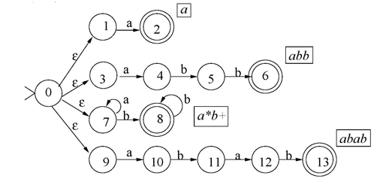
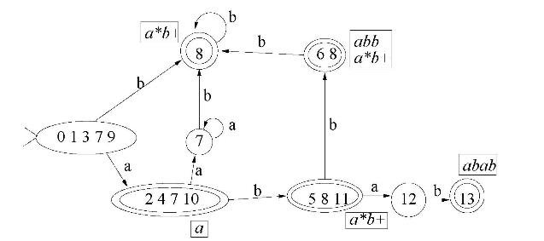
NFA to DFA / Subset Construction Method (Exercise 2)
NFA
DFA
Hints

Slide 16
Deterministic Finite Machine
DFA DESIGN
A finite automaton is a 5-tuple (Q, Σ, δ, q₀, F), where
Q is a finite set called the states,
Σ is a finite set called the alphabet,
δ : Q × Σ → Q is the transition function,
q₀ ∈ Q is the start state,
F ⊆ Q is the set of accept (final) states.
If A is the set of all strings that a machine M accepts, we say that A is the language of machine M and write L(M)=A, M recognizes A or M accepts A.

Slide 17
Deterministic Finite Machine
DFA Example 1
0
1
1
0
q₁
q₂
q₃
DFA DESIGN
M₁ = (Q, Σ, δ, q₀, F), where –
Q = {q₁, q₂, q₃},
Σ = {0, 1},
δ is describe as –
q₀ = q₁,
F = {q₂}.
0,1
Figure: Finite Automaton M₁
δ | 0 | 1
q₁ | q₁ | q₂
q₂ | q₃ | q₂
q₃ | q₂ | q₂
δ(q₁,0) = q₁, δ(q₁,1) = q₂,
δ(q₂,0) = q₃, δ(q₂,1) = q₂,
δ(q₃,0) = q₂, δ(q₃,1) = q₂.
or

Slide 18
0
DFA Design Example
a₁
1
Alphabet Σ={0,1,2}.
Language A₁ = {w : the sum of all the symbols in w is multiple of 3 }.
Can be represented as follows –
S= the sum of all the symbols in w.
If S modulo 3 = 0 then the sum is multiple of 3.
So the sum of all the symbols in w is 0 modulo 3.
Here, a_{i} is modeled as S modulo 3 = i.
The finite state machine M₁= (Q₁, Σ, δ₁, q₁, F₁), where –
Q₁ = {a₀,a₁,a₂},
q₁ = a₀,
F₁ = {a₀},
δ₁ | 0 1 2 . a₀ | a₀ a₁ a₂ a₁ | a₁ a₂ a₀ a₂ | a₂ a₀ a₁
2
1
2
0
a₀
2
a₂
1
0
Input example: 01120101
Present State:
Input symbol:
Accepted
a₂
a₁
a₀
01120101
01120101
01120101
01120101
01120101
01120101
ε
01120101
01120101

Slide 19
DFA Design Example
Alphabet Σ={0,1,2}.
Language A₁ = {w : the sum of all the symbols in w is an even number }.
Can be represented as follows –
S= the sum of all the symbols in w.
If S modulo 2 = 0 then the sum is even.
Here, b_{i} is modeled as S modulo 2 = i.
The finite state machine M₂= (Q₂, Σ, δ₂, q₂, F₂), where –
Q₂ = {b₀,b₁},
q₂ = b₀,
F₂ = {b₀},
δ₂ | 0 1 2 . b₀ | b₀ b₁ b₀ b₁ | b₁ b₀ b₁
b₀
1
b₁
0,2
1
0,2
Input example: 01120101
Present State:
Input symbol:
Accepted
b₀
b₁
01120101
01120101
01120101
01120101
01120101
01120101
01120101
01120101
ε

Slide 20
DFA Design Example (Type 1)
The construction of DFA for languages consisting of strings ending with a particular substring.
Determine the minimum number of states required in the DFA.
Calculate the length of substring.
All strings ending with ‘n’ length substring will always require minimum (n+1) states in the DFA.
Draw those states.
Decide the strings for which DFA will be constructed.
Construct a DFA for the decided strings
While constructing a DFA, Always prefer to use the existing path. Create a new path only when there exists no path to go with.
Send all the left possible combinations to the starting state.
Do not send the left possible combinations over the dead state.

Slide 21
DFA Design Example and Exercise
Draw a DFA for the language accepting strings ending with ‘abb’ over input alphabets ∑ = {a, b}
Draw a DFA for the language accepting strings starting with ‘ab’ over input alphabets ∑ = {a, b}
Draw a DFA for the language accepting strings ‘ab’ in the middle (sub string) over input alphabets ∑ = {a, b}

Slide 22
Lecture References
Portland State University Lectures (Link)
Power set Construction Wikipedia (Link)
Maynooth University Lectures (Link)

Slide 23
References/Books
1. Compilers-Principles, techniques and tools (2nd Edition) V. Aho, Sethi and D. Ullman
2. Principles of Compiler Design (2nd Revised Edition 2009) A. A. Puntambekar
3. Basics of Compiler Design Torben Mogensen

